Slide 1
Cell-free Synthetic Biology
EE-490J
07.11.2023

Slide 2
Objectives
How to purify ribosomes from bacterial cells?
Grow the cells – Culturing
Extract and purify ribosomes from cell lysate
Concentrate PURE proteins from last week
SDS-PAGE analysis of PURE proteins

Slide 3
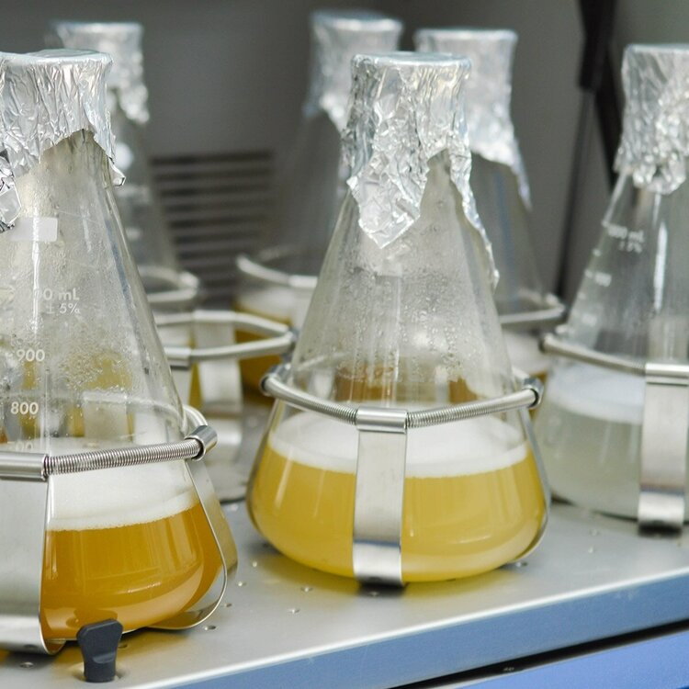
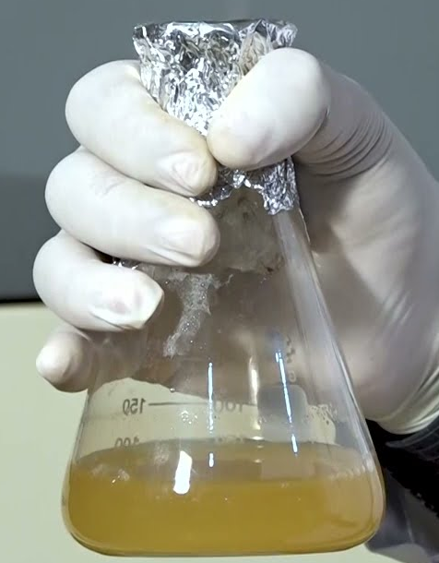
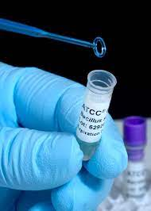
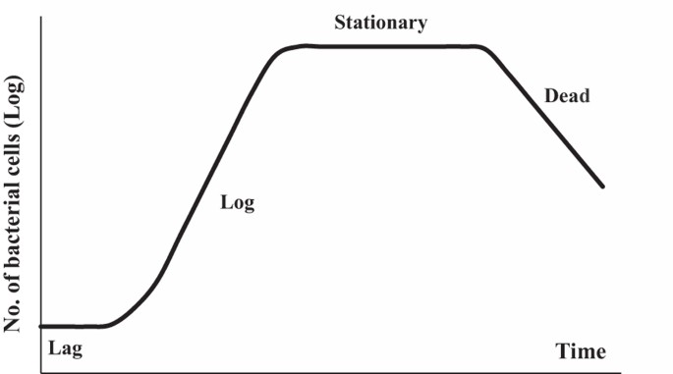
Culturing the cells for ribosome purification
Prepare the overnight culture (mother culture) for cells
E.coli Rb1 strain
14 - 16 h
3 – 4 h
Glycerol stock
Overnight culture
Culture for purification

Slide 4
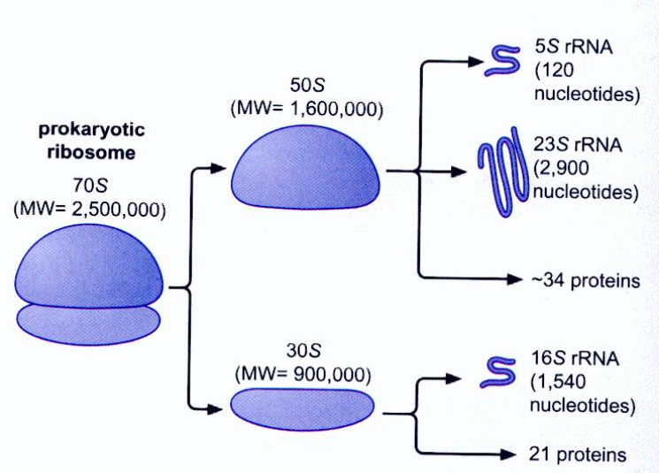
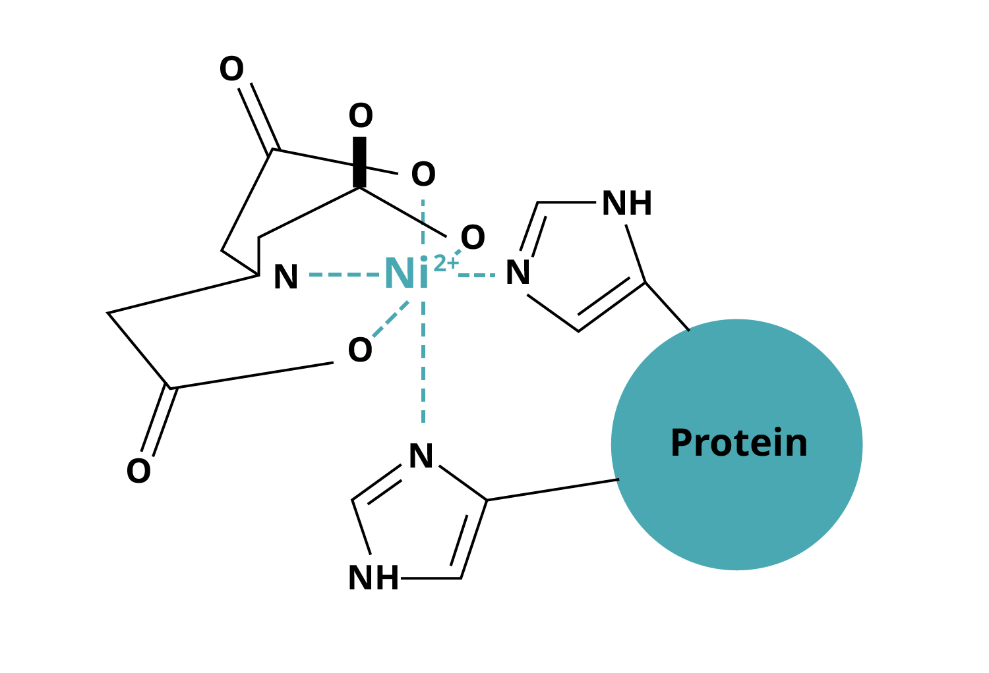
Culturing the cells for ribosome purification
Prepare the overnight culture (mother culture) for cells
E.coli Rb1 strain
His-tagged ribosome (6X)
Genomic insertion of tag at 50S subunit
Constitutively expressed by cells
Ribosome

Slide 5
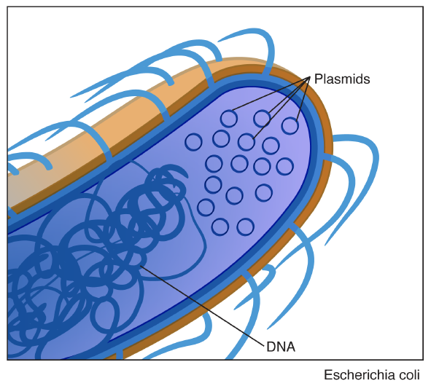
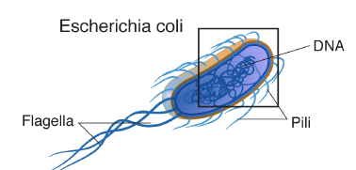

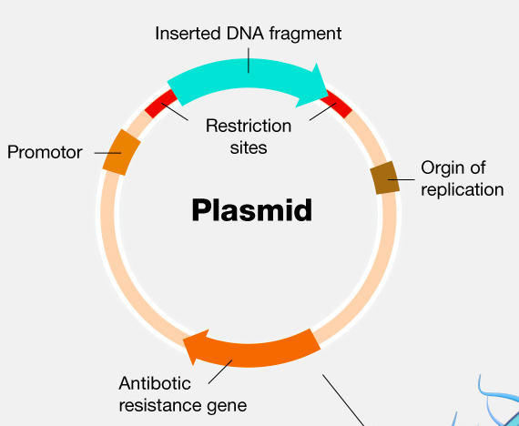
Rb1 his-tagged ribosome

Slide 6
Bacterial growth curve

Slide 7
Culturing the cells for ribosome purification
Prepare the overnight culture (mother culture) for cells
E.coli Rb1 strain
His-tagged ribosome (6X)
Genomic insertion of tag at 50S subunit
Constitutively expressed by cells
Ribosome

Slide 8
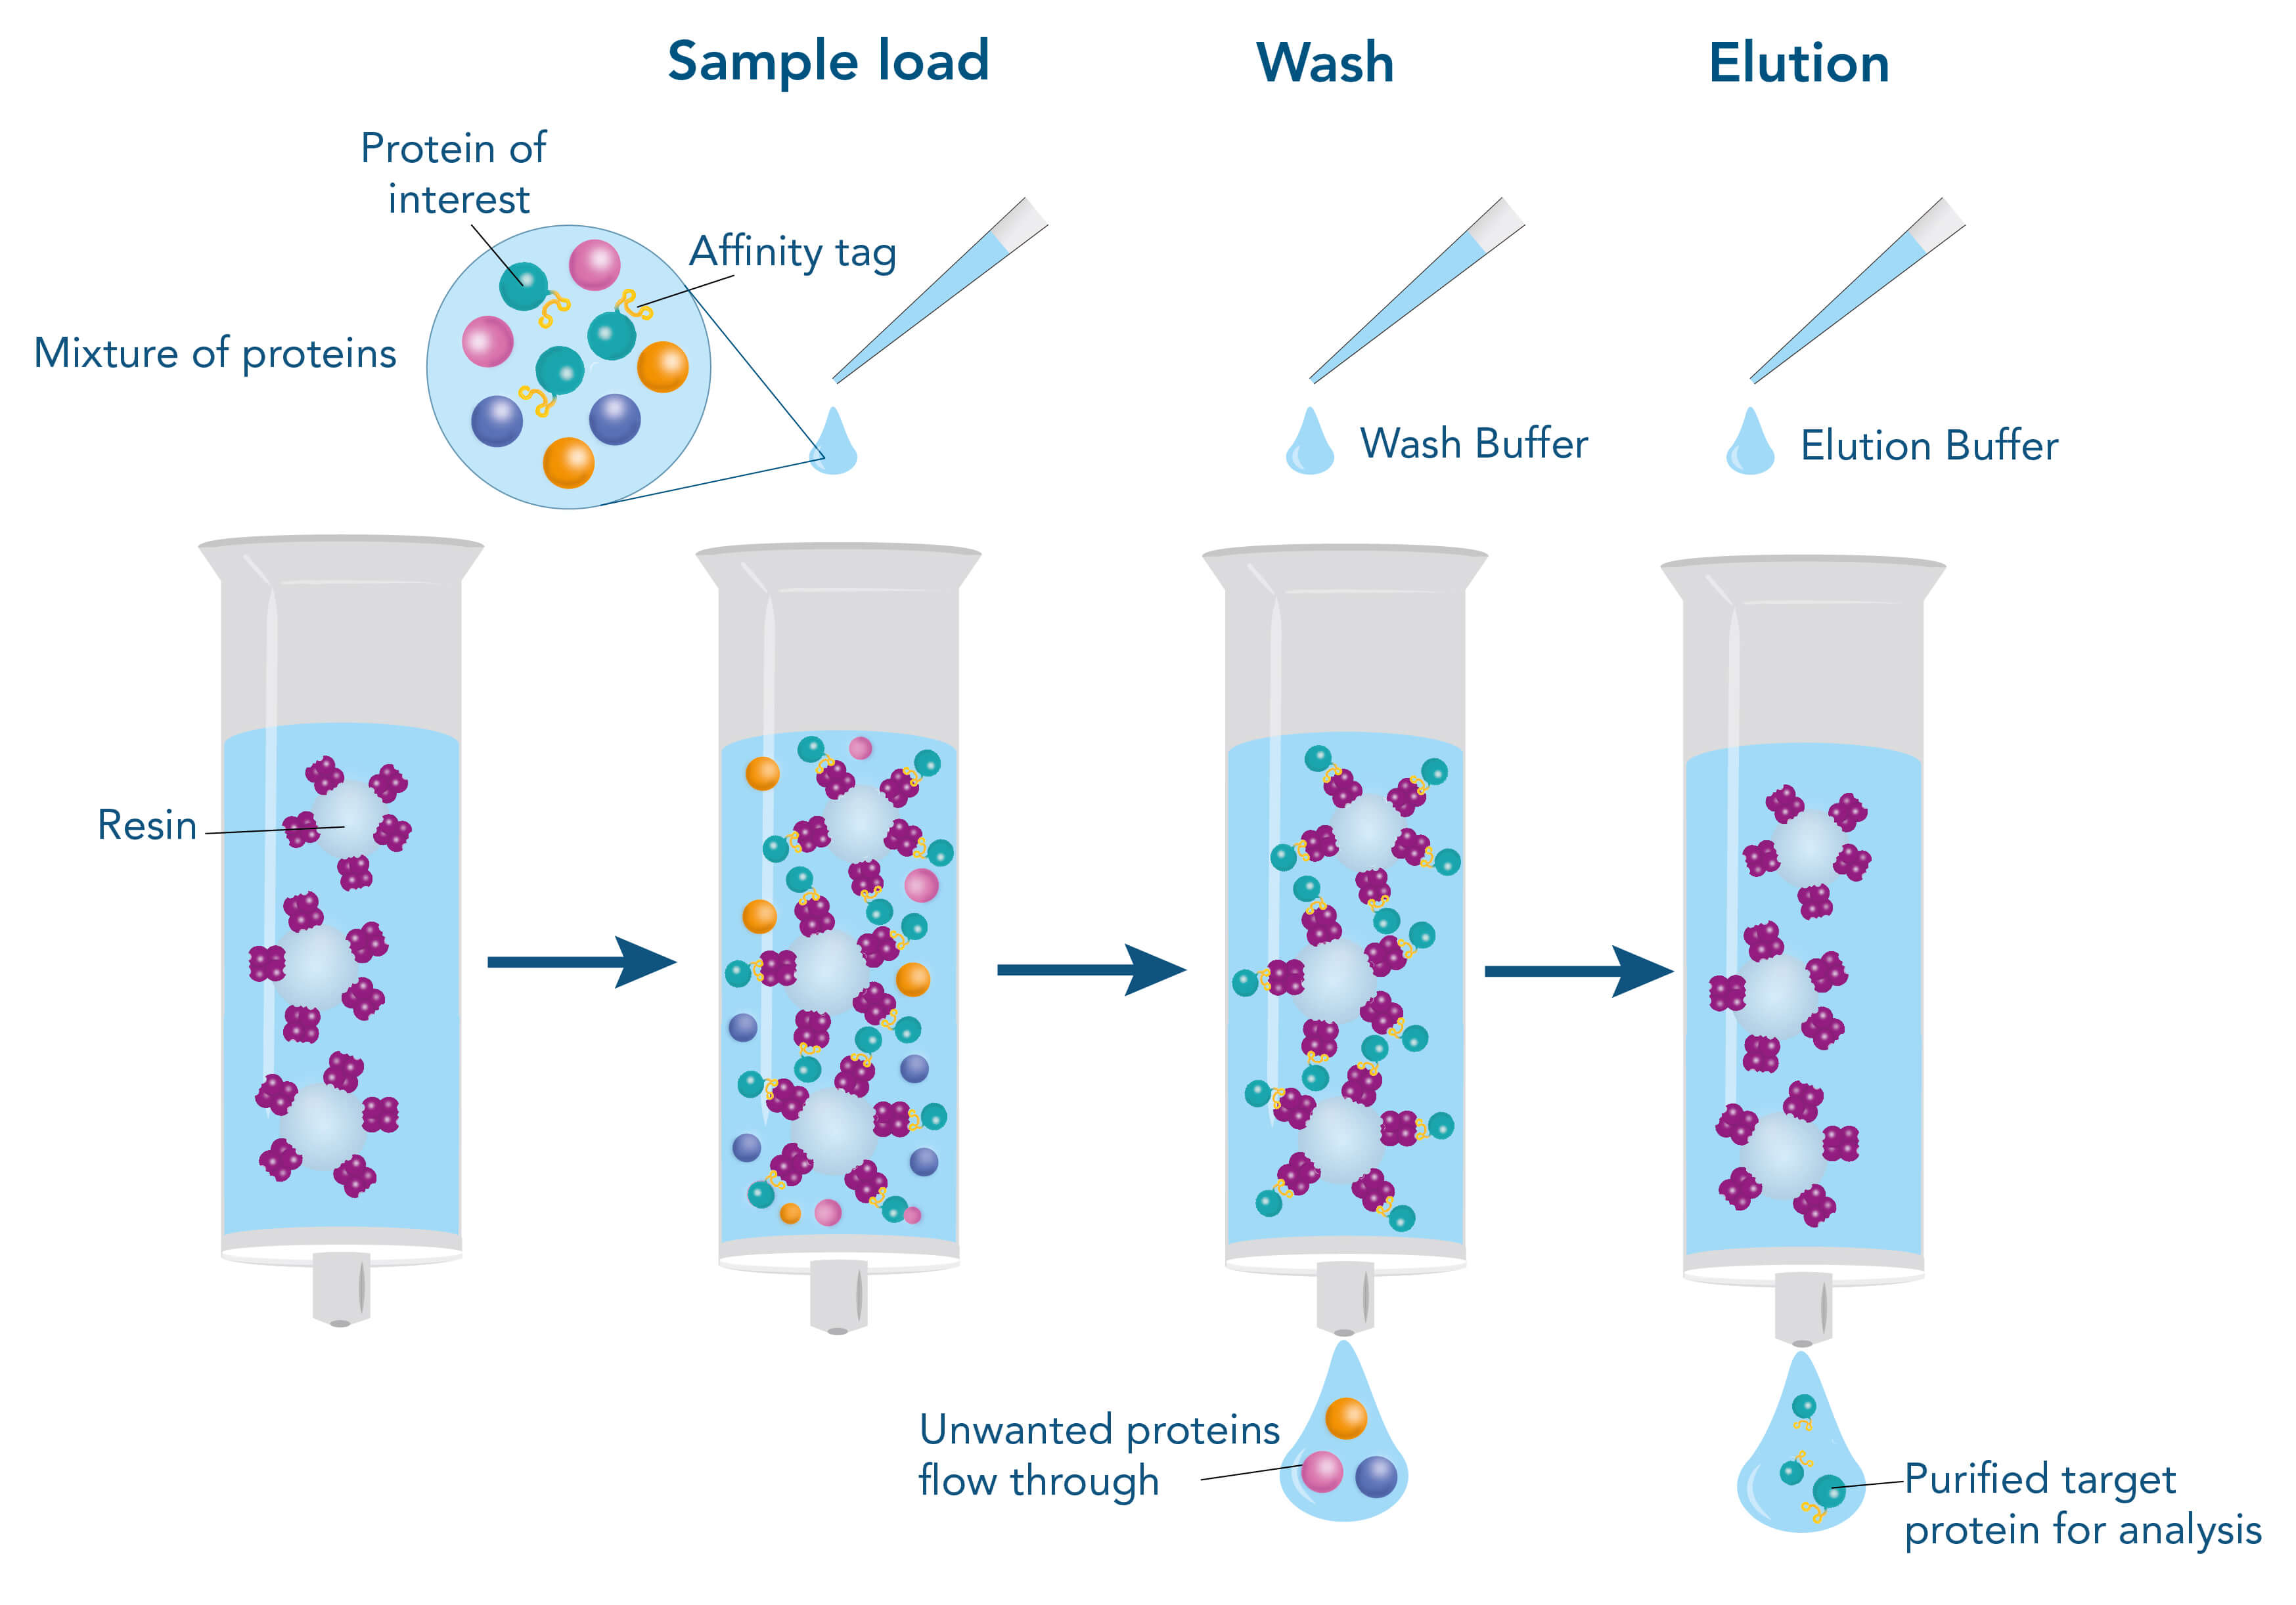
His-tag ribosome purification
Target ribosome
Purified ribosome

